Slide 1




Prepared by:
ONLINE VS OFFLINE EDUCATION
Tahira Batool
Maheen Mohsin
Meerab
Eman
Taha Ahmed
2025-GA-44
2025-GA-33
2025-GA-43
2025-GA-28
2025-GA-42

Slide 2

Introduction to Online VS Offline Education
Education can be learned in two main ways:
Online and Offline
Online learning happens through mobile, laptop, or computer.
Offline learning takes place in a classroom with a teacher.
Both methods help students learn, but in different ways.

Slide 3

What is online education?

Slide 4

ONLINE EDUCATION
Online learning is a method of distance learning using the internet and a computer.
In our country, as in the rest of the world, companies, educational institutions and teachers prefer to implement e-education.
Because some forms of online classes are more suitable for training their employees and students.
Teacher create their own courses, conduct webinars, share knowledge.

Slide 5

Advantages of online education
It is flexible; can be accessed from anywhere with a device and internet connection.
Budget-friendly.
Convenient attendance.
Class recordings are available for later references.

Slide 6

Disadvantages of online education
Internet requirements
Response Barriers
No Interaction
Not real time study

Slide 7

What is offline education?

Slide 8

OFFLINE EDUCATION
Also referred to as traditional training. Offline education means a student needs to go in school, in a classroom, and attend a class face to face with a teacher.
In an offline setting, students listen to long lectures and take notes, sometimes easily get bored and might doze off a little.

Slide 9
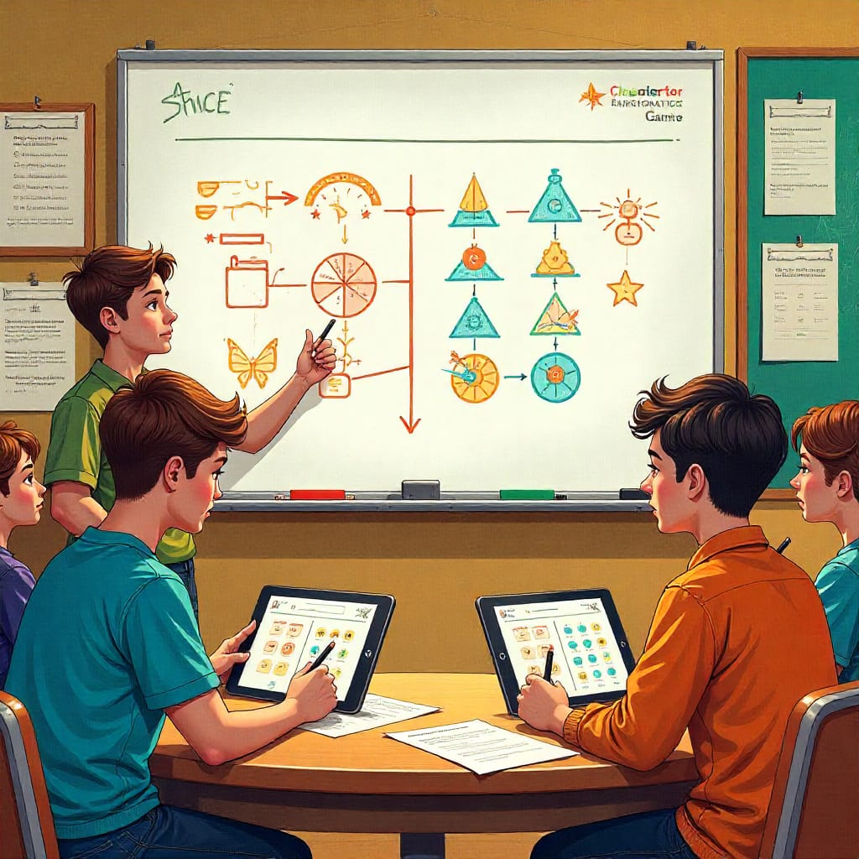
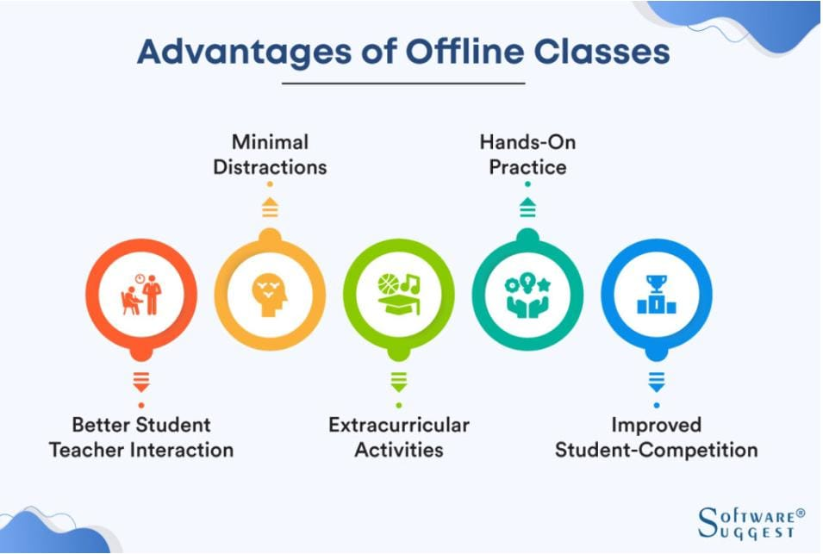
Advantages of offline education
Guidance.
Real time education.
High learning.
No isolation.
True form of learning

Slide 10
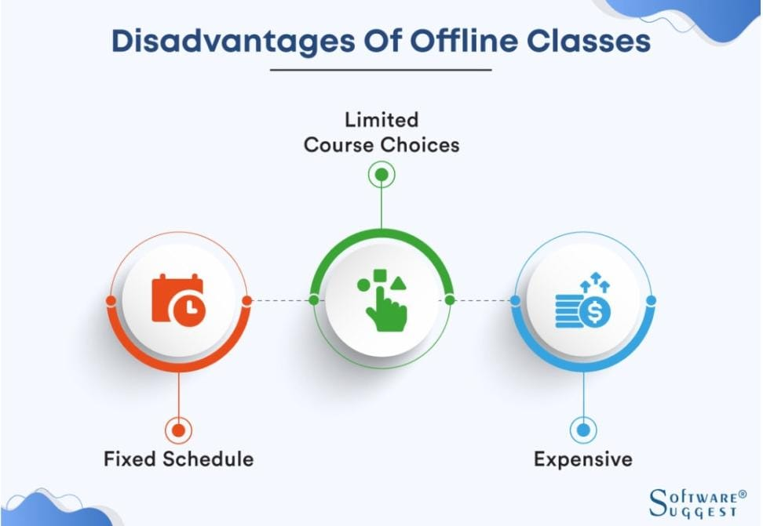
Disadvantages of offline education
Students may lack the opportunity to learn advancing technology.
Time management becomes an issue for students who reside far away from campus.
No recording or any other form of data is not always available for students who missed the class or later references.

Slide 11

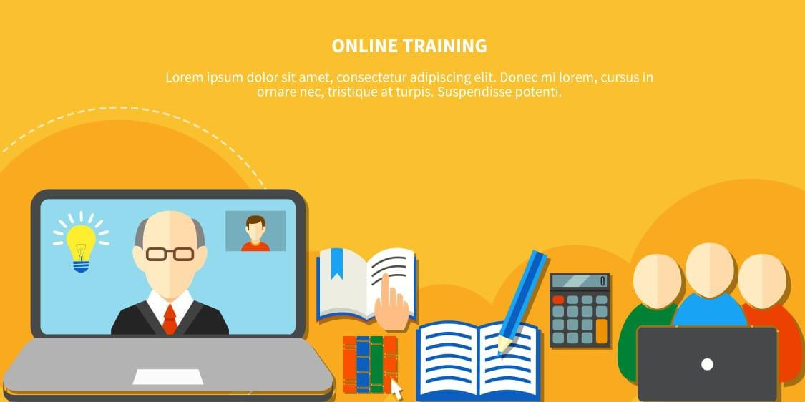
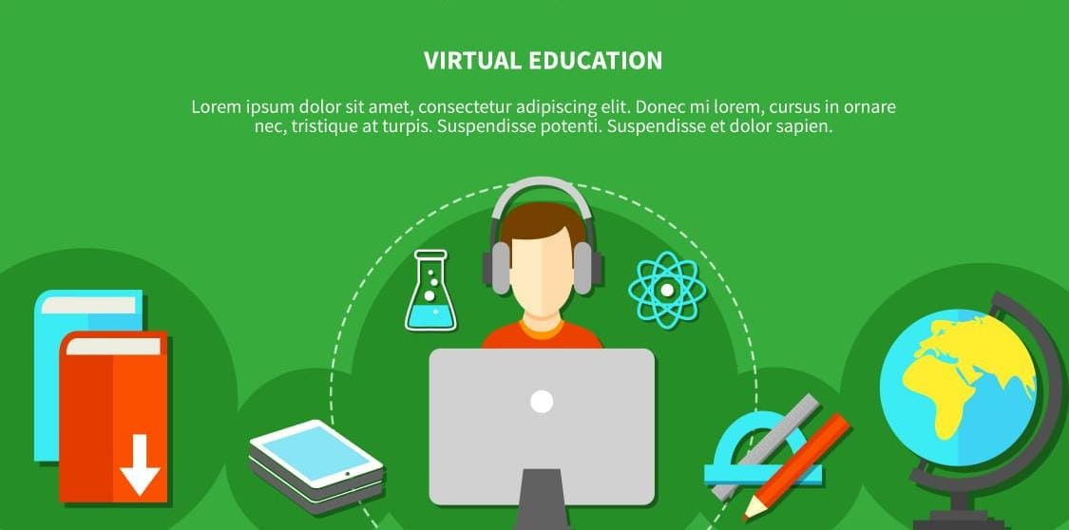
COMPARISON
ONLINE EDUCATION
OFFLINE EDUCATION
Digitalized tools and methods of teaching.
Cost-effective and time-saving.
Virtual classrooms.
Online classes have a flexible schedule.
Traditional tools and methods of teaching.
More expensive than online education and consumes more time.
Physical classrooms.
Offline classes have a fixed and strict schedule.

Slide 12
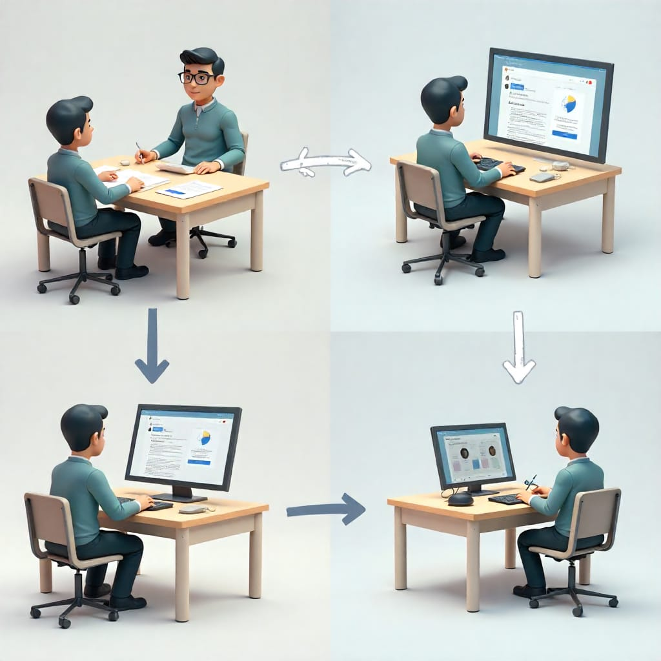
Conclusion
Online education is convenient wherever you want to give it anytime and in any situation and has less basic requirements than offline education. Online education is generally preferred by non-school students as well. But students learning online do not have easy access to teachers. So the problems of these students do not go away quickly.

Slide 13

THANK YOU

